Slide 1
Review of Exemplary CAR# 163915695

Slide 2
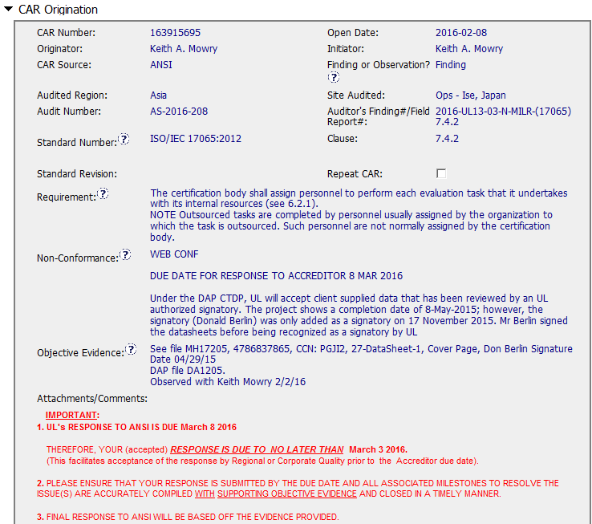

Slide 3
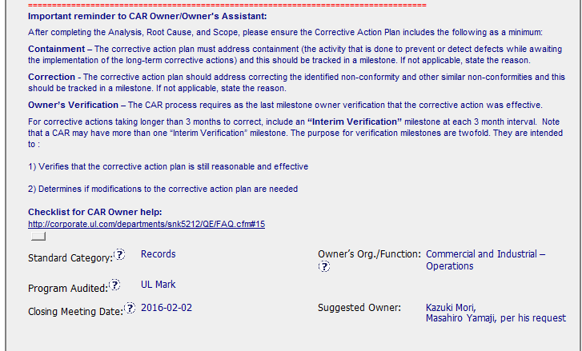
Provided help to complete Finding information.

Slide 4
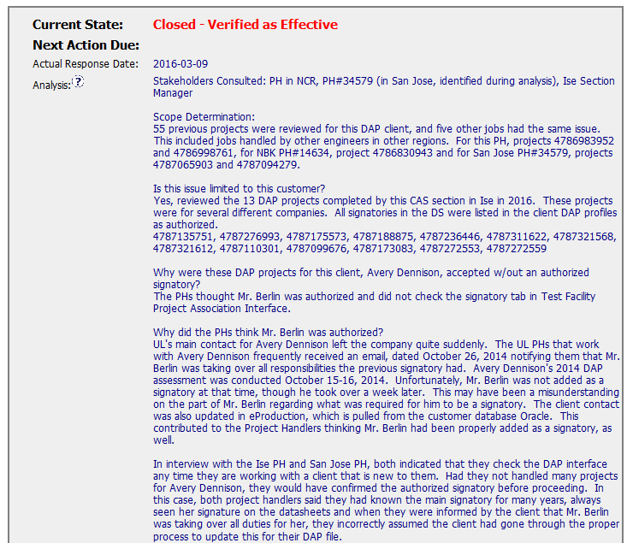
All areas were identified: Stakeholders, questioning of issues to get to root cause.

Slide 5
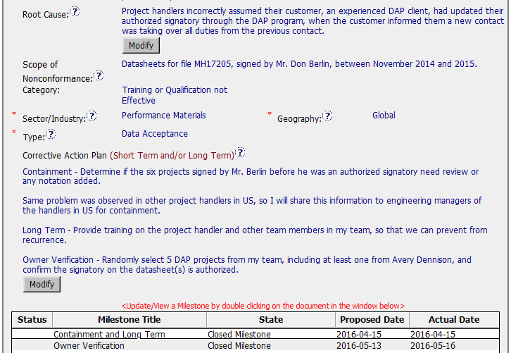
Containment, Action Plan and Verification are all identified.
Milestones were well developed, no extensions needed.

Slide 6
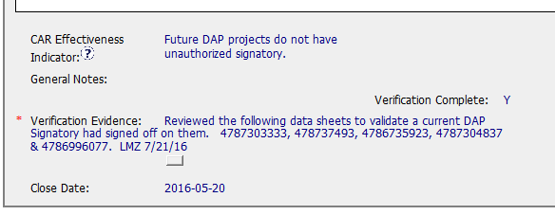
CAR was verified as effective within 2 months.

Slide 7
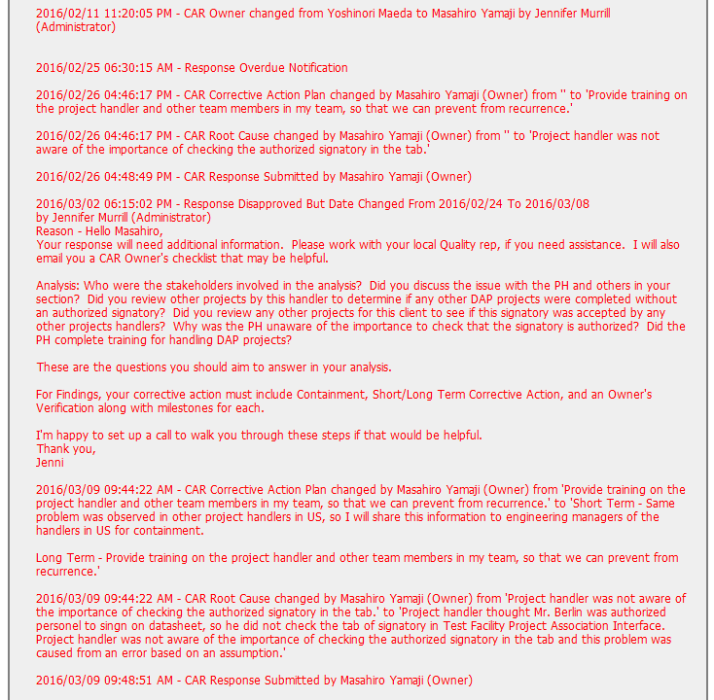
Communication with client throughout the process and identifying the missing pieces.

